Slide 1
A core Course on Modeling
Introduction to Modeling
0LAB0 0LBB0 0LCB0 0LDB0
c.w.a.m.v.overveld@tue.nl
v.a.j.borghuis@tue.nl
S.30

Slide 2
Conclusion: interpret result
Reflection: right outcome?
define
formulate
purpose
Right problem?
(problem validation)
conceptualize
identify
entities
choose
relations
Right concepts?
(concepts validation)
formalize
obtain
values
formalize
relations
Right model?
(model verification)
execute
operate
model
obtain
result
Right outcome?
(outcome verification)
Right answer?
(answer verification)
conclude
present
result
interpret
result
Notes:
2

Slide 3
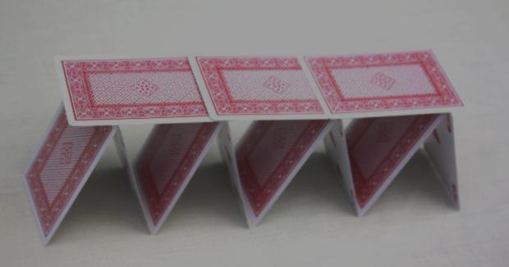
Confidence for glass box models (numerical confidence)
Quantitative validation:
in a glass box model, input uncertainties may be amplified or dampened.
http://www.morguefile.com/archive/display/588958
output uncertainty
input uncertainty
Notes:
3

Slide 4
Confidence for glass box models (numerical confidence)
Quantitative validation:
in a glass box model, input uncertainties may be amplified or dampened.
http://www.morguefile.com/archive/display/229070
output uncertainty
output uncertainty
input uncertainty
input uncertainty
Notes:
4

Slide 5
Confidence for glass box models (numerical confidence)
Quantitative validation:
in a glass box model, input uncertainties may be amplified or dampened.
QUIZ
http://www.morguefile.com/archive/display/229070
How do amplification or dampening relate to derivatives?
output uncertainty
output uncertainty
input uncertainty
input uncertainty
Notes:
5

Slide 6
Confidence for glass box models (numerical confidence)
Quantitative validation:
in a glass box model, input uncertainties may be amplified or dampened.
http://www.morguefile.com/archive/display/229070
output uncertainty
output uncertainty
input uncertainty
input uncertainty
Notes:
6

Slide 7
Confidence for glass box models (numerical confidence)
Quantitative validation:
in a glass box model, input uncertainties may be amplified or dampened.
For y=f(x), spreading in x causes spreading in y.
For small δx , we have
δy = (δy / δx) δx ≈ (dy/dx) δx
= f ’(x) δx
http://www.morguefile.com/archive/display/531309
output uncertainty
output uncertainty
input uncertainty
input uncertainty
Notes:
7

Slide 8
Confidence for glass box models (numerical confidence)
Quantitative validation:
in a glass box model, input uncertainties may be amplified or dampened.
So for relative spreading δy/y and δx/x (expressed in %), we have
(δy/y) / (δx/x) = f ’(x) x/y := c(x) (condition number).
http://www.morguefile.com/archive/display/531309
output uncertainty
output uncertainty
input uncertainty
input uncertainty
Notes:
8

Slide 9
Confidence for glass box models (numerical confidence)
Quantitative validation:
in a glass box model, input uncertainties may be amplified or dampened.
c(x)=1: 5% spread in x causes 5% spread in y.
Large c(x): instable!
The condition number is the ratio in relative spreading between output and input: the propagation of uncertainty.
http://www.morguefile.com/archive/display/531309
output uncertainty
output uncertainty
input uncertainty
input uncertainty
Notes:
9

Slide 10
Confidence for glass box models (numerical confidence)
For y=f(x), we have
(δy/y)=c(x) (δx/x)
What about y=f(x₁,x₂,x₃,…)?
http://www.morguefile.com/archive/display/165272
Notes:
10

Slide 11
Confidence for glass box models (numerical confidence)
For y=f(x), we have
(δy/y)=c(x) (δx/x)
What about y=f(x₁,x₂,x₃,…)?
QUIZ
How do uncertainties in two or more input quantities contribute in the total uncertainty of the outcome?
http://www.morguefile.com/archive/display/165272
Notes:
11

Slide 12
Confidence for glass box models (numerical confidence)
For y=f(x), we have
(δy/y)=c(x) (δx/x)
What about y=f(x₁,x₂,x₃,…)?
First try:
(δy/y)=∑_{i} | c(x_{i}) | (δx_{i}/x_{i}).
This is too pessimistic: if x_{i} are independent, they will not all be extreme at the same time. A better formula is:
(δy/y)²= ∑_{i} c²(x_{i}) (δx_{i}/x_{i})².
http://www.morguefile.com/archive/display/165272
Notes:
12

Slide 13
Confidence for glass box models (numerical confidence)
Propagation of uncertainty: (δy/y)²= ∑_{i} c²(x_{i}) (δx_{i}/x_{i})² .
Properties:
All δx_{i} /x_{i} occur squared. Therefore, spreading proportional to √n rather than n for n arguments.
All c_{i} occur squared. So even if ∂f/∂x_{i}<0: no compensation with ‘negative contributions’.
One rotten apple …
To seek room for improvement, search for x_{i} with large δ_{i} and large c_{i}.
http://cdn.morguefile.com/imageData/public/files/j/jeltovski/preview/fldr_2011_08_20/file8111313896923.jpg
Notes:
13

Slide 14
Summary
Confidence for glass box models:
Structural validity: do we believe the mechanism inside the glass box?
Numerical validity: what is the numerical uncertainty of the model outcome?
Sensitivity analysis and the propagation of uncertainty in input data: these are expressed in terms of the condition numbers.
Sensitivity analysis helps to decide if a model should be improved.
Notes:
14

